Slide 1
PAWS-CMDA: Parallel Web-Service Climate Model Diagnostic Analyzer
Seungwon Lee (PI)
Jonathan Jiang (Co-I)
Lei Pan (Co-I)
Chengxing Zhai (Co-I)
Joao Teixeira (Collaborator)

Slide 2
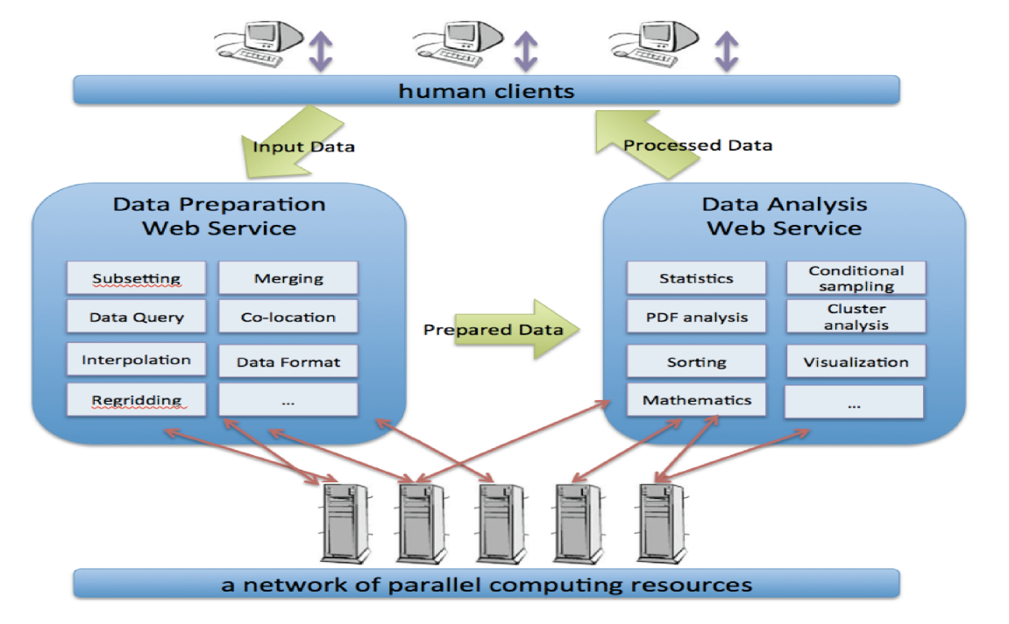
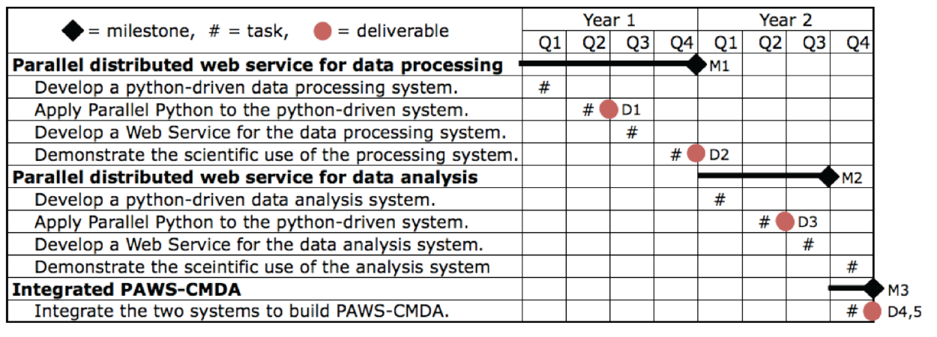
PAWS-CMDA: Parallel Web-Service Climate Model Diagnostic Analyzer PI: Seungwon Lee
Objective
Develop a parallel, distributed web-service oriented system to enable multi-aspect physics-based and phenomenon-oriented climate model performance evaluation and diagnosis through the comprehensive and synergistic us of multiple observational data, reanalysis data, and model outputs.
Significance
Scientific and technological advances in NASA’s climate and weather predictions through multivariate conditional sampling approaches and parallel and distributed web service technologies.
Functional architecture diagram for PAWS-CMDA
Approach
Develop Python-driven data preparation and analysis system. Wrap the existing data analysis tools in Python for integration into the system.
Apply Parallel Python to achieve large-scale distributed parallelism. Use Parallel Python to establish a server network, distribute sub-tasks to and retrieve results from the server network.
Build web services of the data preparation and analysis system with a dual access mode: web browsers and programs.
Task Schedules and Key Milestones
Tasks partially completed:
Developed a python-driven data processing/analysis system.
Developed a web service for the data processing system.
Tasks for next 6 months:
Add new capabilities to the data processing/analysis system.
Apply the Parallel Python where appropriate.
Co-Is/Collaborators
Lei Pan, Chengxing Zhai, Jonathan Jiang, Joao Teixeira

Slide 3
Outline
Technical Status
Programmatic Status
Educational and Outreach Status
Future Work
Connections with Other CMAC Projects

Slide 4
Technical Status Summary
Adopted legacy data analysis tools to the requirement of PAWS-CMDA (from Matlab to Octave).
Developed a Python-driven system with the data analysis tools (Uniform interface between the computational code and web services).
Built web services with the Python-driven system (Flask, Gunicorn & Tornado).
Designed web browser interface for the web services (an intuitive and easy access to the web services).
Purchased a project dedicated machine consisting of three computing servers and one 100-TB raid storage.
Virtualized web servers for flexible service development and deployment.

Slide 5
Functional Architecture Diagram

Slide 6
Adapting Existing Tools
Existing Matlab code is adapted to this project.
The adaptation only requires to develop interface routines that facilitate data passing between user and core functions.
To meet the requirement of large scalability of PAWS-CMDA, we use GNU Octave, which is a license-free version of Matlab.
A minimal adjustment of the existing Matlab code is needed to make it executable in Octave environment.
Data format difference in reading netcdf files
A few capabilities from some matlab toolboxes, e.g. costal line for map, juliandate
Current capabilities of the adapted Octave code:
2D variable map display
2D variable time series and zonal mean plots
Near Future capabilities
3D variable zonal mean, vertical profiles, 2D slice map, time series

Slide 7
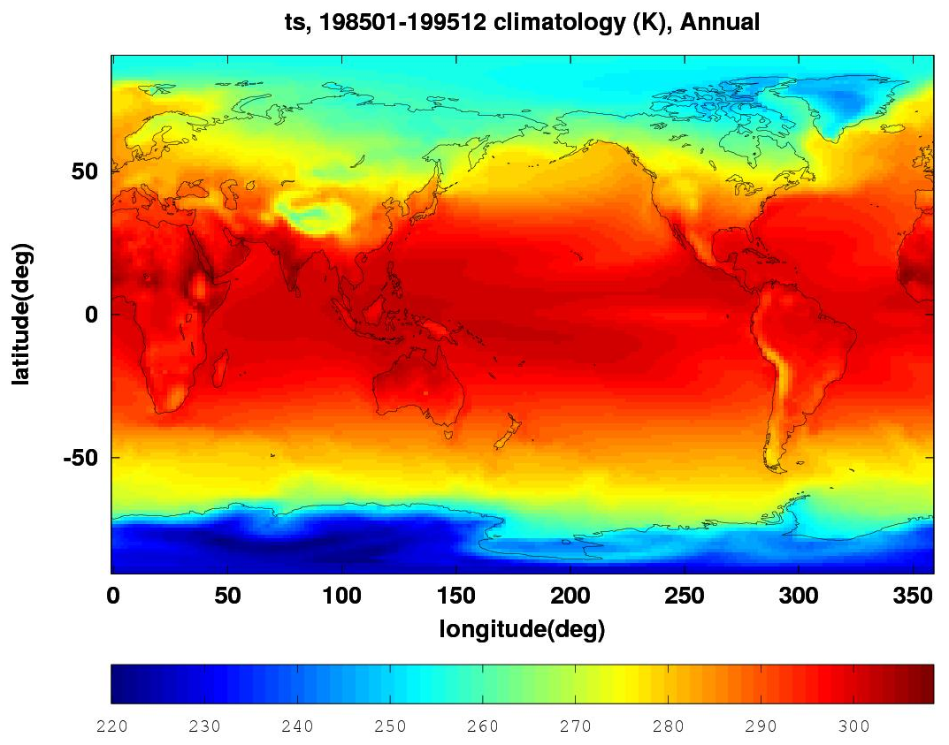
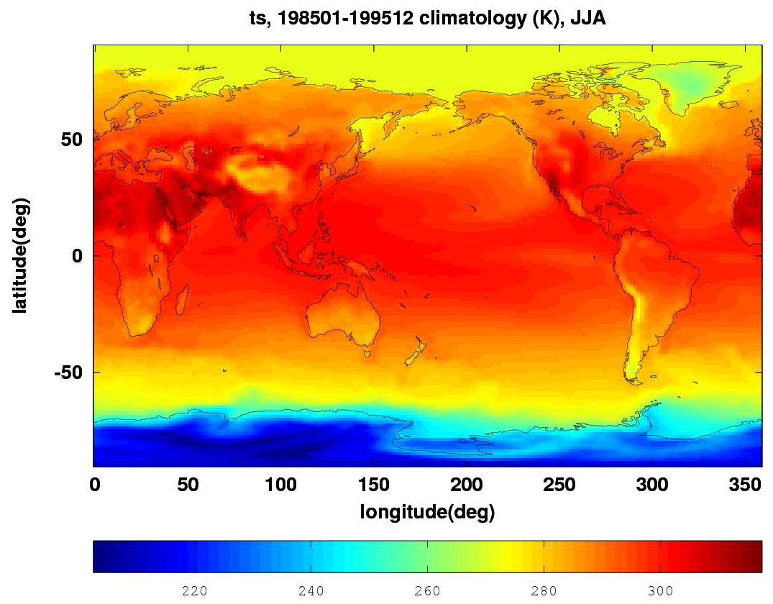
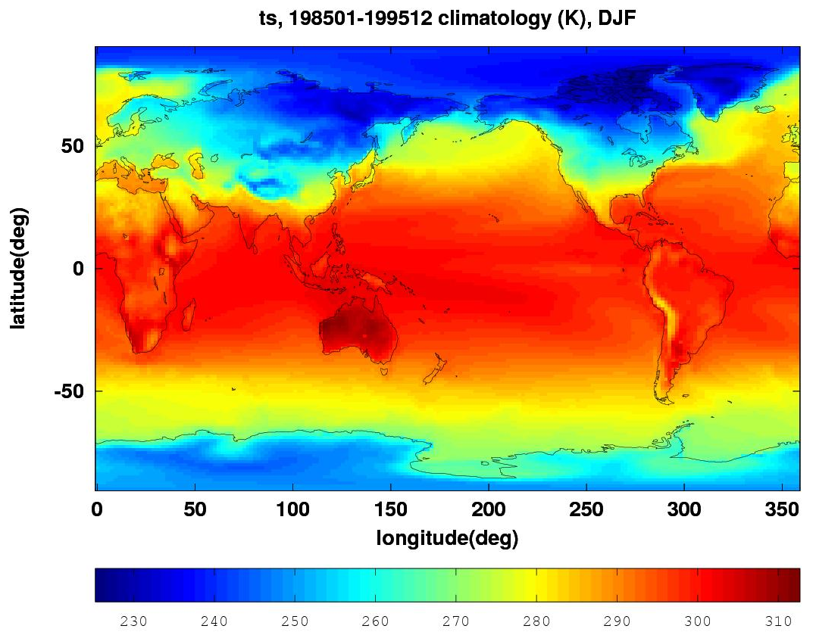
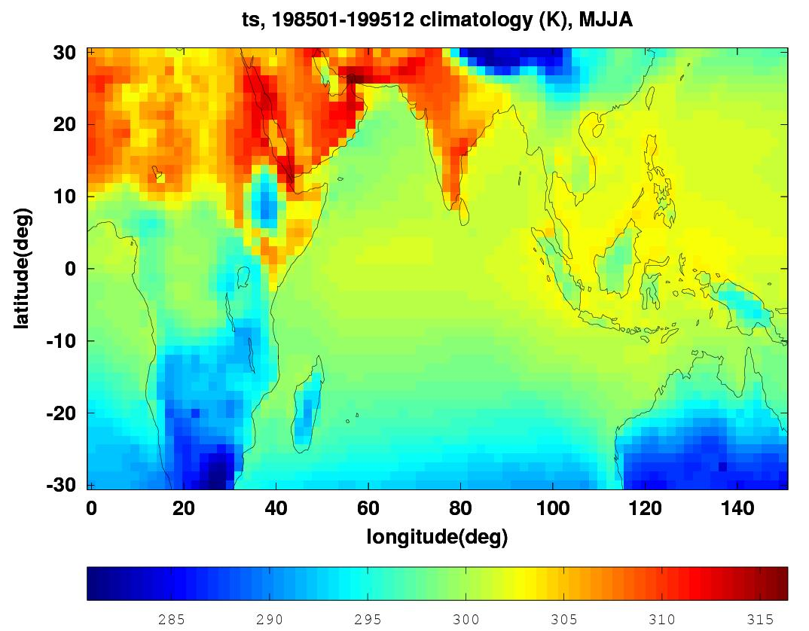
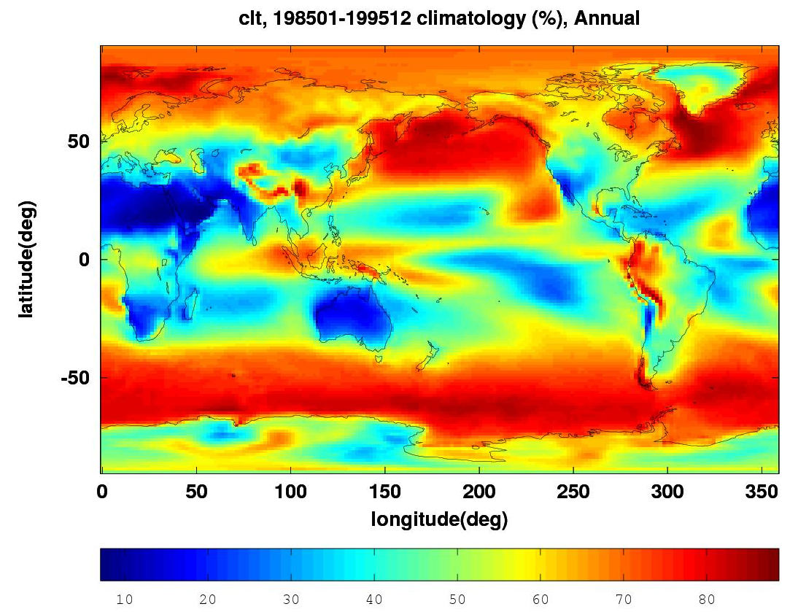
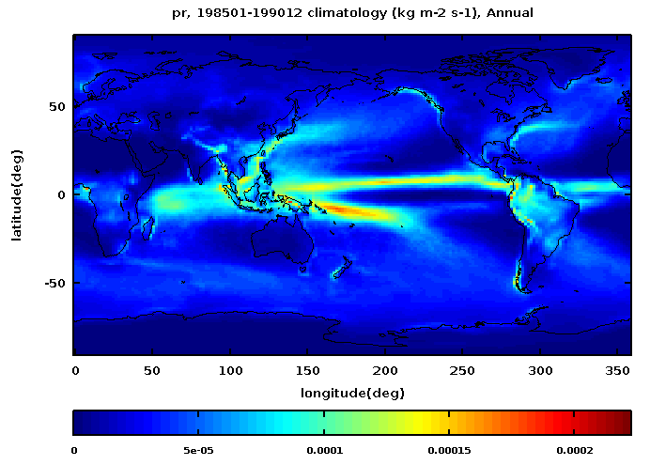
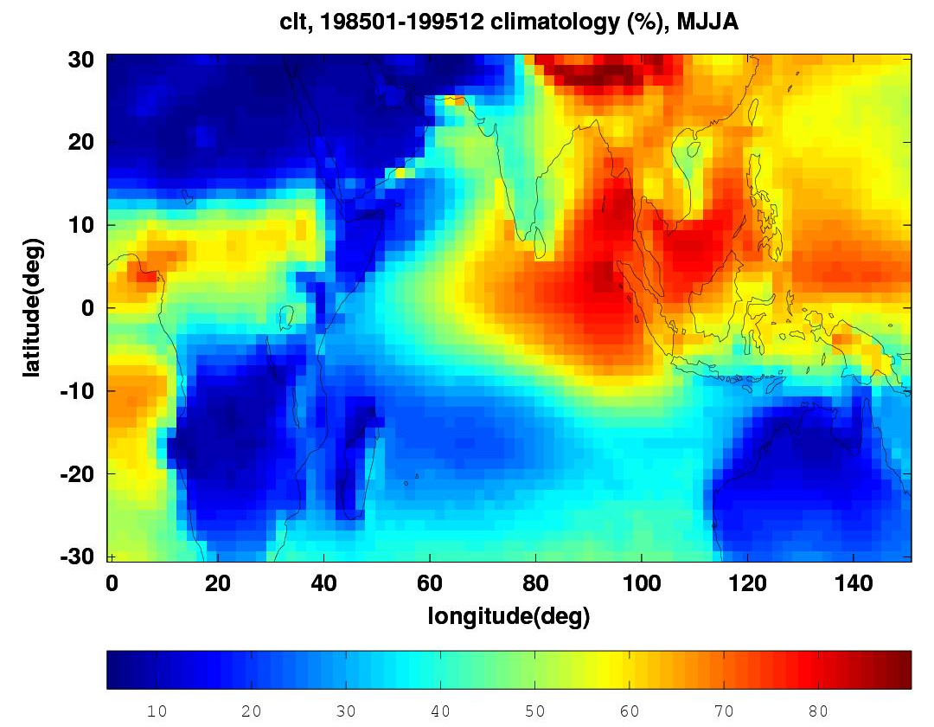
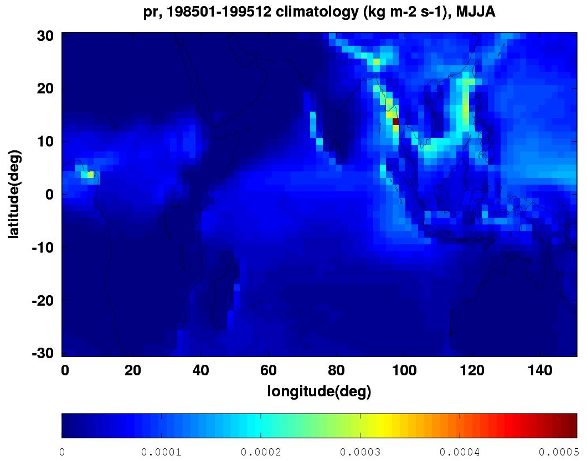
Examples of current capabilities (I)
Display a two dimensional physical variable on a map as function of longitude and latitude
Temporal average is computed for a specified range
User may choose a subset of months in a year to study seasonal variation
Displayed region may be customized for examining details
Surface temperature, annual, summer winter
summer, region
cloud fraction
Precipitation
cloud fraction, region
Precipitation, region

Slide 8
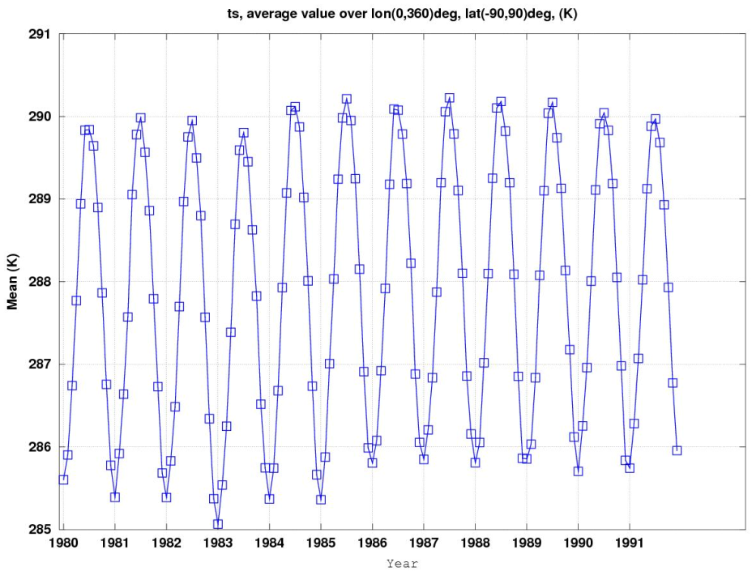
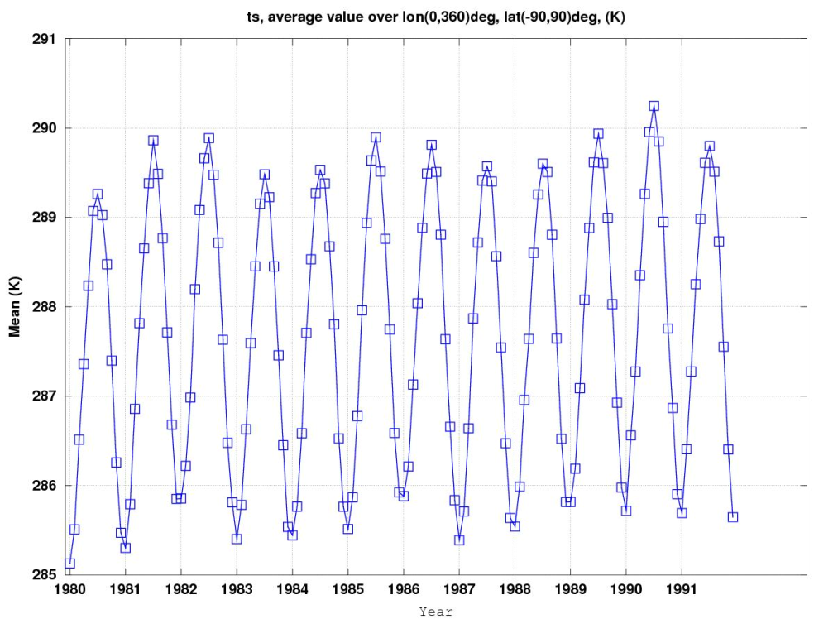
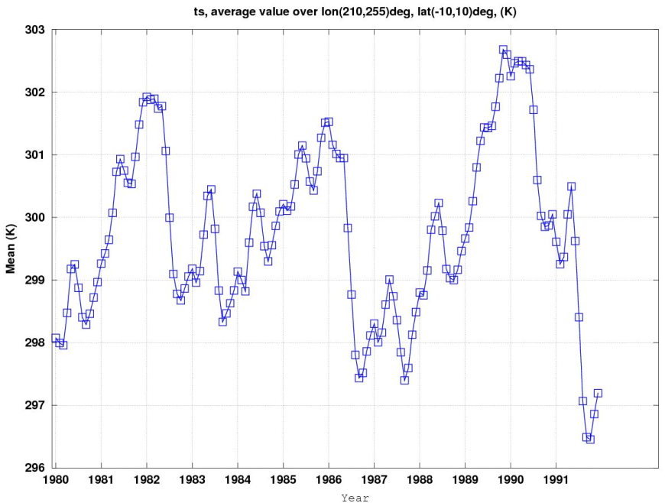
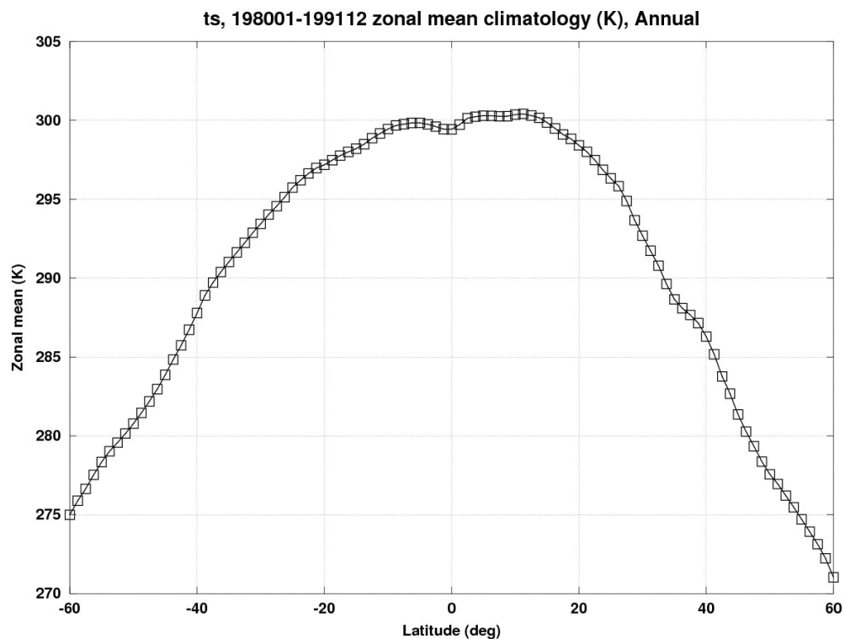
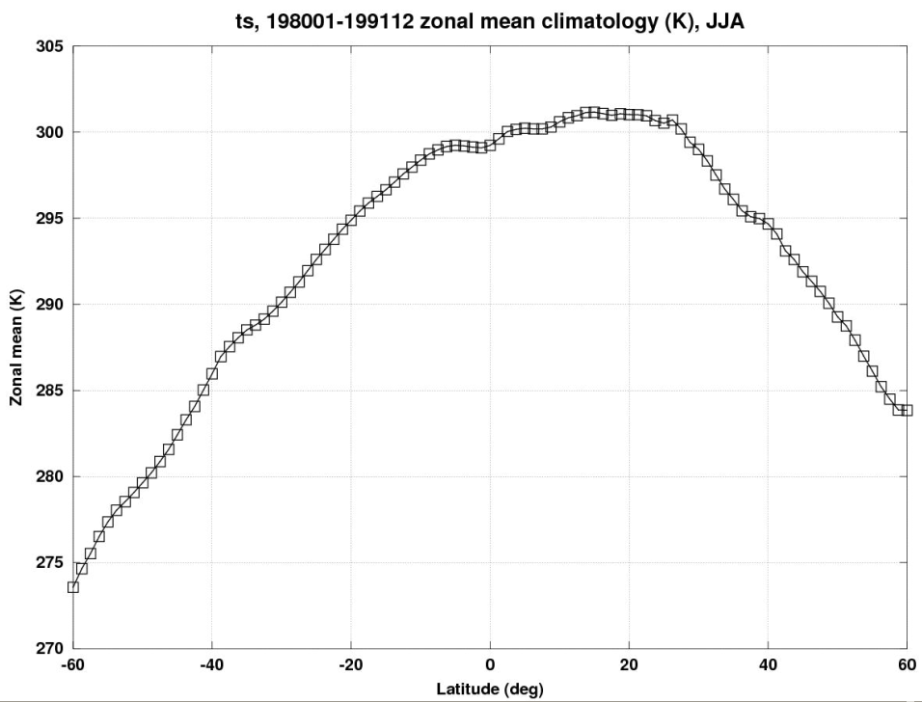
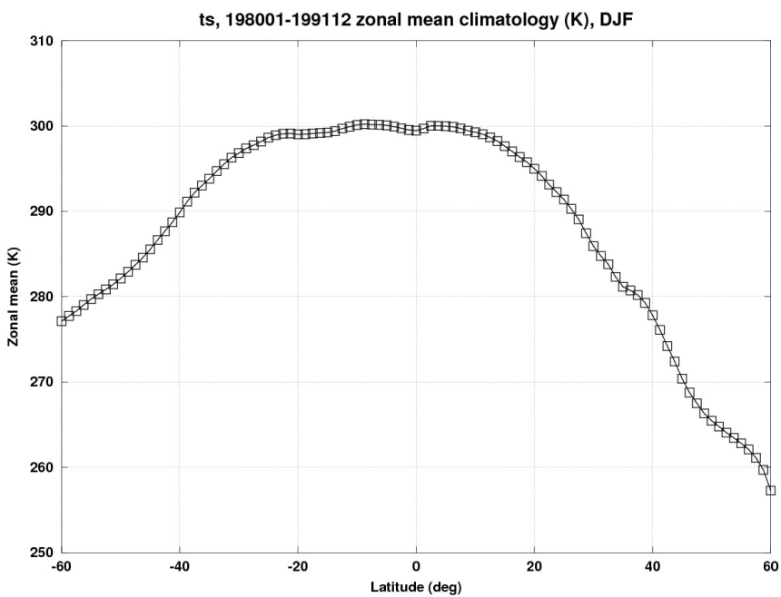
Examples of current capabilities (II)
Plot the time series of a two dimensional physical variable averaged over a specified region
Plot the zonal mean of a two dimensional physical variable averaged over a temporal period vs latitude
User may select months in a year for study seasonal variation
Surface
Temperature
Time series
UKMO_hadgem2-es
NCAR-cam5
NCAR-cam5, Nino 3
Surface
Temperature
zonal means
annual
summer, JJA
winter, DJF

Slide 9
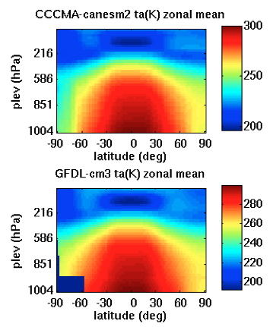
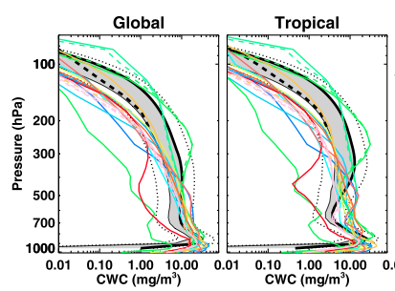
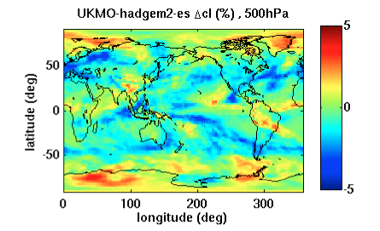
Future capability examples
From Jiang el al, 2012
Vertical profile of cloud water content
Zonal mean of air temperature
Cloud fraction change at 500hPa

Slide 10
Developing Python-Driven System
Wrap legacy data analysis tools for integration into the system.
Application code in GNU Octave (a free Matlab)
Use python caller code to spawn off the App. as a child process (using python subprocess)
The python caller prepares all input arguments for the child process
The python caller defines where the child process puts its results (e.g., images) using input argument
The stdout and stderr of child process are captured by the python caller at joining point (the way for the App. to communicate back to the python caller)
The legacy App. now looks like a python application

Slide 11
Building Web Services
Use Flask, an open source microframework for python apps.
Provide entry point code
Parse input arguments from client
Call aforementioned python app., passing input arguments
Get return values and pass them to client in Json format
REST-ful style: scoping info. placed in URI and method info. conveyed in HTTP method
Example: http://cmacws.jpl.nasa.gov:8089/twoDimMap/display?model=ukmo_hadgem2-a&var=ts&start_time=199001&end_time=199512&lon1=0&lon2=100&lat1=-29&lat2=29&months=1,2,3
Define port number and location of static data
Separate app. traffic from static HTTP traffic
Use Gunicorn to provide Web Server Gateway Interface (WSGI) service (app.)
Use Tornado to provide web service (static HTTP)

Slide 12
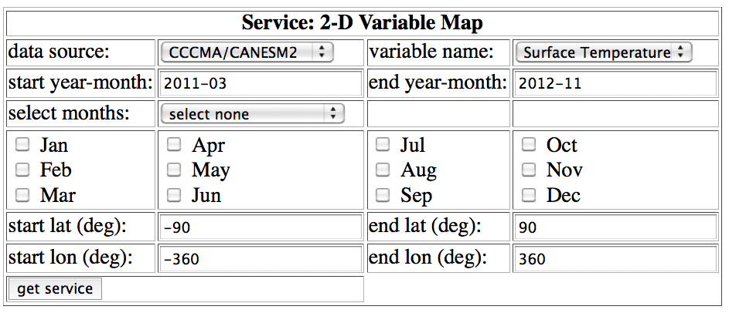
Building Web Browser Interface
Designed web browser interface for our web services.
Provide an intuitive and easy access to the web services.
Will use JavaScript and AJAX to implement the web browser interface.

Slide 13
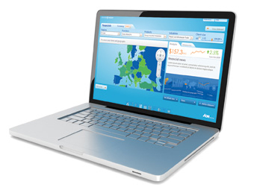


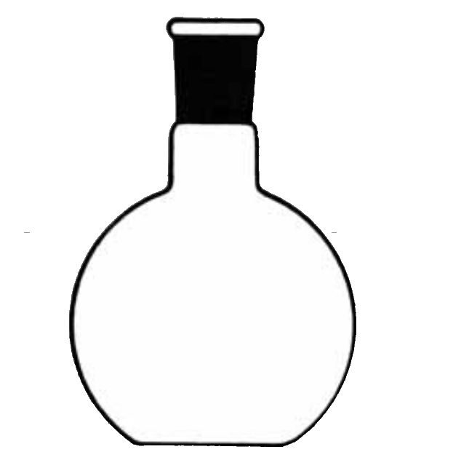



Service Diagram with Technical Components
Client
(Web Browser, or program)
URI
(scoping + method)
URI
(results)
JSON
Octave App.

Slide 14
Virtualizing Service
Use VMWare (VMPlayer)
Host OS: CentOS (Linux)
Guest OS: Ubuntu (Linux)
Open source software, python packages, etc. installed on guest OS
Services deployed to guest OS
Developers’ user accounts are on guest OS
RAID disk, with 100TB capacity, is mapped from host OS to guest OS
Host ports need to be open and forwarded to guest OS
Benefits: guest OS runs on any host OS, so moving is quick; no need to reinstall all the dependent packages again

Slide 15
Project Machine Purchase and Installation
We purchased a machine dedicated for this project at the cost of $30K in January 2013.
The project machine consists of
Two servers, each having 12 cores, 64 GB physical memory, and 4 TB disk space.
One RAID storage server with 100 TB usable space, 12 cores, and 64 GB physical memory.
One Gigabit switch to connect the three servers.
OS installation
CentOS Linux
RAID server made head node (JPL LAN IP)
Two servers made compute nodes (local IP: 192.xxx.xxx.xxx)
RAID cross mounted to all nodes
/home shared by all nodes
VMWare player (free) installed for virtualization

Slide 16
Outline
Technical Status
Programmatic Status
Educational and Outreach Status
Future Work
Connections with Other CMAC Projects

Slide 17
Programmatic Status
This CMAC project started on October 1st, 2012.
This project total budget is $616K with $303K for year 1 and $313K for year 2.
This project has 9 tasks, 5 deliverables, and 3 milestones.
The schedule/order of the tasks is adjusted to improve the development cycle and support the new educational opportunity.
4 tasks are partially completed and 1 task is delayed.
The project cost is overrun by $16K as of the end of February.
The overrun is due to the overrun in hardware purchase and installation.
The overrun will be corrected by the gradual reduction of the labor cost through the rest of the year.

Slide 18
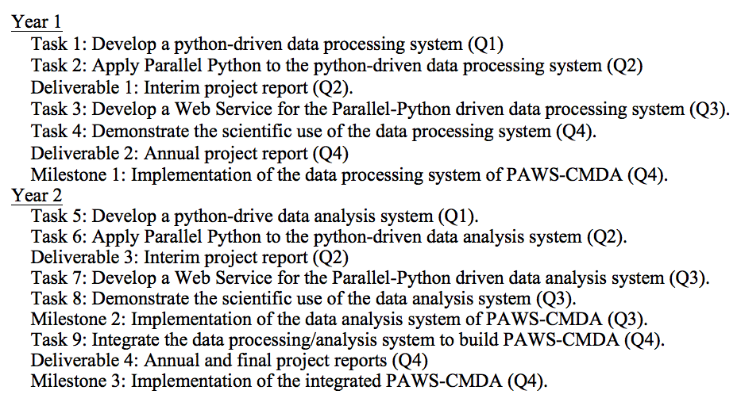
Project Schedule Planned

Slide 19
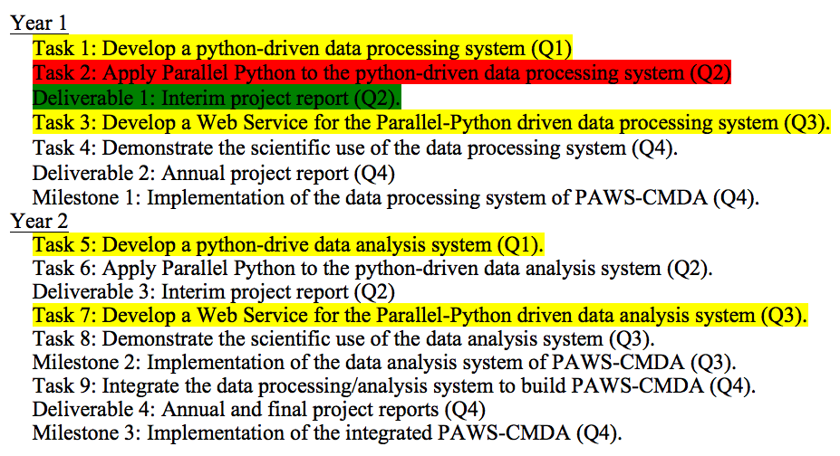
Project Schedule Status
Complete
Partially complete
Not started

Slide 20
Project Schedule Adjustment
The project schedule is adjusted improve the development cycle and support the new educational opportunity.
The underlying technologies/infrastructures are common for both the data processing and analysis systems.
The capabilities in both the data processing and analysis systems are needed to support the CCS summer school educational curriculum.
The subsets of the data processing and analysis systems are developed.
Complete
Partially complete
Not started

Slide 21
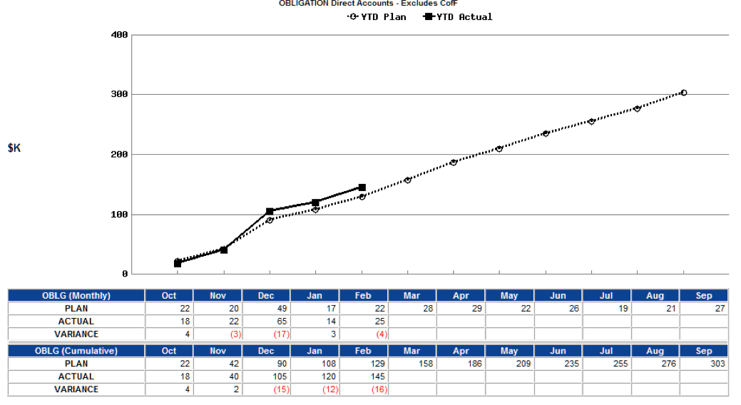
Project Cost Status
Total project budget for Year 1 is $303K.
As of the end of February, the project cost is overrun by $16K.
Overrun by $16K is due to the purchase and installation of the hardware.
While $20K was planned for the hardware purchase and installation, the actual cost was $36K.
The overrun will be corrected by the gradual reduction of the labor cost through the rest of the year.

Slide 22
Outline
Technical Status
Programmatic Status
Educational and Outreach Status
Future Work
Connections with Other CMAC Projects

Slide 23
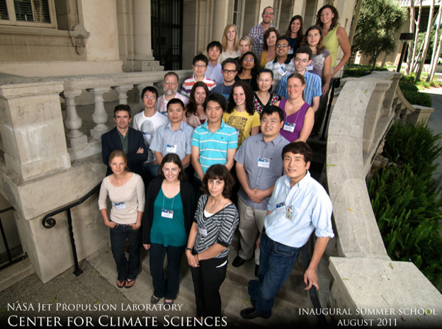
Educational and Outreach Status
Presented the planned work and current work status of this CMAC project at 2012 AGU Fall meeting in San Francisco, CA, December 2012.
This CMAC project agreed to work with CCS and make a demonstration of the tool in April, 2013. Upon a positive response, the tool will be used as an educational tool for the summer school.
Design and requirements for the education tool have been developed: the user interface should be web-browser based; the web server should support >30 simultaneous web-service requests.
Several web-services to support model-data intercomparisons are being developed: analysis and visualization of 2D/3D variable multi-annual means using Coupled Model Intercomparison Project Phase 5 (CMIP5) model outputs and Obs4MIPs datasets.
Potentially, CCS may provide a fund to customize our tool for its education use.
The Center for Climate Sciences (CCS) in JPL showed interest in using PAWS-CMDA as an education tool for a summer school hosted by CCS in 2013.
The summer school will bring together the next generation of climate scientists – about 30 graduate students and postdocs from around the world – to engage with premier climate scientists from JPL and elsewhere. http://climatesciences.jpl.nasa.gov/events/summer-school

Slide 24
CCS Summer School Tool & Curriculum
The CCS summer school education tool will be a web-browser based tool.
The tool will support the following functionalities:
2D variable map of annual means with spatial and temporal selection
2D variable zonal means with temporal selection
2D variable time series with spatial and temporal selection
3D variable vertical profile with spatial and temporal selection
3D variable zonal mean profiles with temporal selection
3D variable slice map with spatial, temporal and vertical level selection
The tool will be used to support the following curriculum:
Learn the aspects of both model outputs and NASA satellite observations.
Compare the model outputs with the observation datasets.
Consider the effect of the observation uncertainty and limitation on the model comparison.
Report model systematic biases if exist.
Examine the potential causes of the model biases.

Slide 25
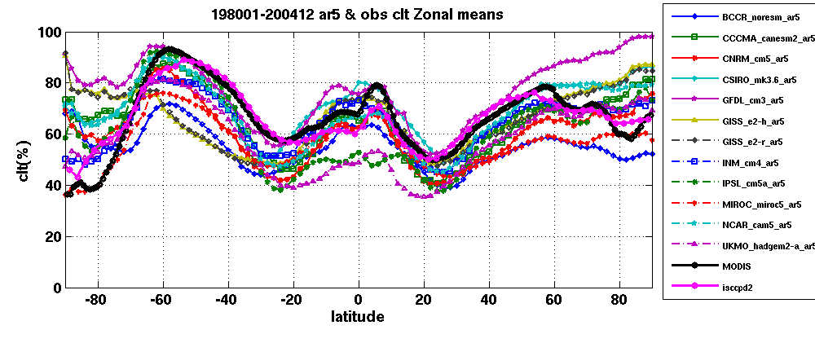
Example of planned summer school exercises
The students will be asked to use the monthly mean CMIP5 model outputs and Obs4MIPs datasets to compute and plot the zonal mean total cloud fractions as shown below and report model systematic biases if exist. The students will be also asked to consider the observation uncertainty and limitation and their effect on the comparison with model outputs.

Slide 26
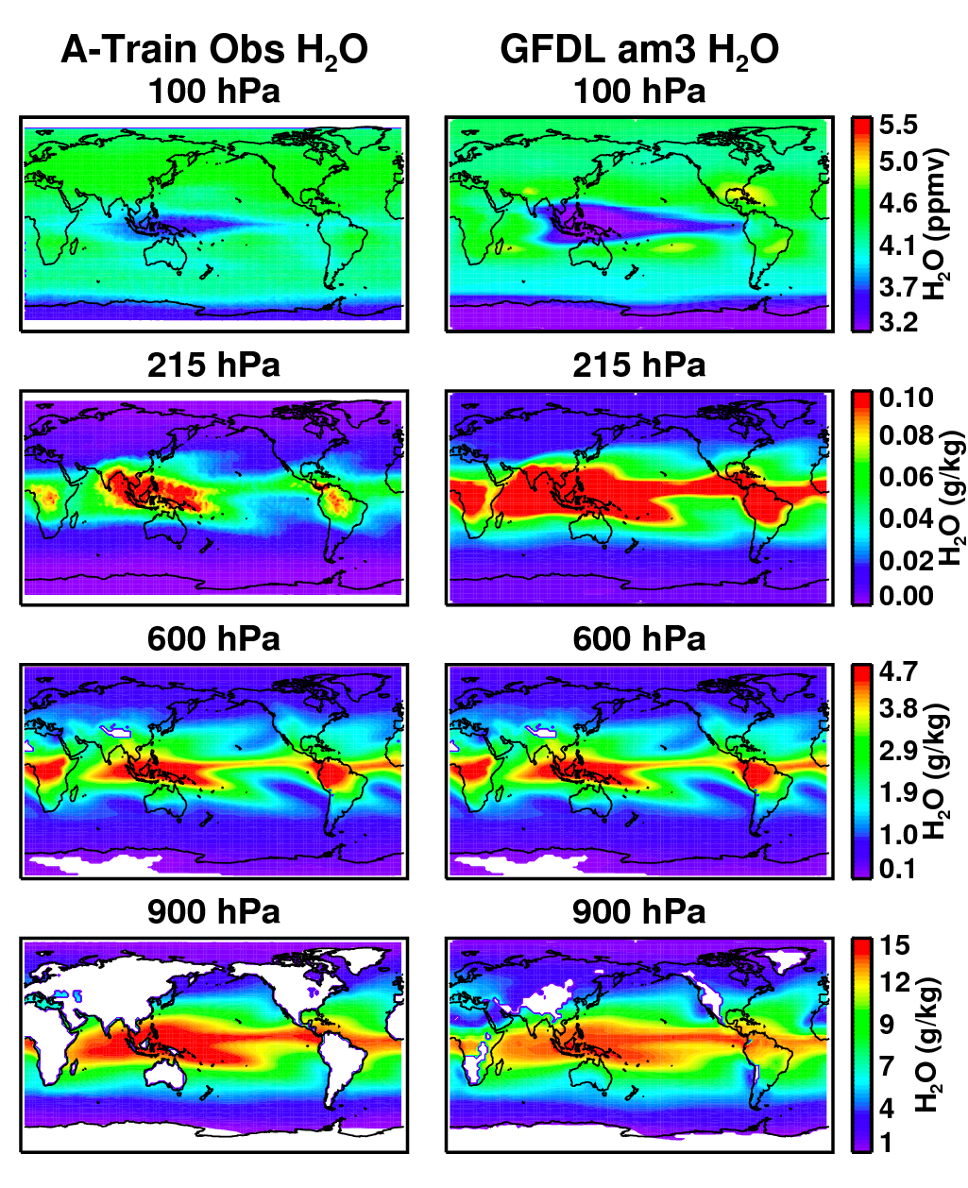
Example of planned summer school exercises
The students will be asked to plot a 3d model parameter (e.g. water vapor H₂O, air temperature) at several different pressure levels (e.g. 100hPa, 215hPa, 600hPa, 900hPa) and compare the model results with Obs4MIPs observational data and report model biases if exist.
The students will be also asked to analyze the potential causes of the systematic model biases.

Slide 27
Outline
Technical Status
Programmatic Status
Educational and Outreach Status
Future Work
Connections with Other CMAC Projects

Slide 28
Future Work
Add new capabilities to the data processing/analysis system.
Build Web Services for the new capabilities.
Apply the Parallel Python for large- data and computation consuming jobs where appropriate.
Integrate the data processing/analysis systems to build PAWS-CMDA.
New work (not included in the proposed work):
Develop a scalable job scheduler and queue manager to distribute many small job requests in the server network.
Publish PAWS-CMDA in the NASA Earth Exchange (NEX).

Slide 29
Connection with Other CMAC Projects
Project Name | Connection | Action
Next generation cyberinfrastructure to support comparison of satellite observations with climate models | We could use their software. | We will develop common API conventions to use their software for data access and discovery services.
Integrating parallel and distributed data mining algorithms into the NASA Earth Exchange (NEX) | We could use their software. | We will discuss the scope of the datasets and model outputs that they will include in their system and determine whether there is an overlap between our data and their data.
MERRA Analytic Services (MERRA/AS) | We could use their software. They could use our software. | We will use MERRA reanalysis data and MapReduce results through the MERRA/AS API. They could use our web services for MERRA data analyses.
Computational education and internship training for environmental science students | We could collaborate on development of educational tools and curricula. | We will share our experience in developing educational tools and curricula.

Slide 30
Acronym List
PAWS-CMDA: Parallel Web-Service Climate Model Diagnostic Analyzer
CCS: The Center for Climate Sciences in JPL
CMIP5: Coupled Model Intercomparison Project Phase 5
Obs4MIPs: A pilot activity to make observational data products more accessible for climate model intercomparisons
WSGI: Web Server Gateway Interface

Slide 31
Backup Slides

Slide 32
Content Guide
Include a cover page, quad chart, technical information and achievements, a list of technical publications, programmatic (including a milestone schedule and actual vs. planned costs since project inception), student pictures and involvement (including the degree they are pursuing), if applicable, and an acronym list. Acronyms should be spelled out the first time they are used. Each slide should stand on its own and contain sufficient explanation to enable future reviewers of the presentation to understand the information presented without the benefit of having participated in the review itself.
Describe the primary findings, technology development results, and technical status, e.g., status of elements, construction of breadboards or prototype implementations, results of tests and/or proof-of-concept demonstrations, etc.
Describe the work planned for the remainder of the project and critical issues that need to be resolved to successfully complete the remaining planned work.
Summarize the cost and schedule status of the project, including any schedule slippage/acceleration. A schedule milestone chart of all major task activities shall be created and maintained and shown at all reviews. A cost data sheet shall be created and maintained, showing total project costs obligated and costed, along with a graphical representation of the project cost run outs.
Report any educational and outreach components of the project, e.g., graduate degrees, educational activities; technology infusion or patents applied for or granted; journal or conference publications; presentations at professional conference, seminars and symposia; demonstrations; media exposure; and, other activities that contributed to the overall success of the research project.
An assessment of the technology readiness level of the components, sub-systems, and systems of the project.

